Slide 2

Bhagavan’s Educational Philosophy and Integral Educational System at SSSIHL

Slide 3
Five Questions that a Student Ought to Pose
A genuine student is one who contemplates on these five issues and understands them thoroughly.
What is meant by 'education?'
What kind of education we must pursue?
What should be the educational standards?
What type of education contributes to the all-round human development?
What benefits do we derive from the present system of education?

Slide 4
The Underlying Philosophy
The Sai educational institutions have been established not merely to enable students to earn a living but to make them acquire good traits, lead ideal lives, and give them ethical, moral and spiritual strength. I have established them with a view to inculcate love and teach good qualities to students. They will learn here humility, discipline and faith. I have established these institutions to impart spiritual education as a main component and worldly education as a secondary one. Education should enable one to cultivate good qualities, character and devotion. The teaching of the university curricula is only the means employed for the end, namely, spiritual uplift, self-discovery and social service through love and detachment. This will be a Gurukula - a place where teachers and taught will grow together in love and wisdom - and like the ancient system of education, it will develop in its students a broad outlook and promote virtues and morals, which serve to foster noble ideals in society. This Institute will be a temple of learning where youth are shaped into self-reliant, contented and enterprising heroes of action and self-sacrifice, for the purpose of serving humanity.
SRI SATHYA SAI BABA
Revered Founder Chancellor, SSSIHL

Slide 5
Philosophy of Education
Base all education efforts on building up the character of students and then you can confidently think of raising on it the superstructure of curricula, etc. Pupils must know the secrets of a happy life and of happy co-operation with other members of the community. Bhagawan Sri Sathya Sai Baba
Founder Chancellor

Slide 6
Variations of Education – Bhagavan’s Perspective
Thus education is of two types:
the first type is concerned merely with gathering of information and understanding about the external phenomenal world;
while the second type involves deep understanding and assimilation of knowledge, which is known as ‘Educare’.

Slide 7
Philosophy of Education at SSSIHL
Philosophy of Education at SSSIHL
Education is not for mere living; It is for Life.
The end of Education is Character:
Individual Character
National Character
Living with God is True Education
Adhyatma Vidya Vidyanam - Spiritually oriented Education system is verily perfect education system.
Sreddhavan Labhate Jnanam – Samsayatma Vinasyate.
“Sathyam Vada, Dharmam Chara” – “Speak the Truth, Conduct yourself righteously”.
Love for God; Fear of Sin; Morality in Society
Education is not for mere living; It is for Life.
The end of Education is Character:
Individual Character
National Character
Living with God is True Education
Adhyatma Vidya Vidyanam - Spiritually oriented Education system is verily perfect education system.
“Sathyam Vada, Dharmam Chara” – “Speak the Truth, Conduct yourself righteously”.
Love for God; Fear of Sin; Morality in Society

Slide 8
INTEGRAL EDUCATION SYSTEM
Education which integrates:
the Head,
the Heart, and
the Hands of the student.
Education system which fosters:
The Head of Shankara
The Heart of Buddha
The Hands of Janaka
Hands in the Society and Head in the Forest

Slide 9
Integral Education
⚪Life lessons learnt through the message of the Revered Founder Chancellor, Bhagavan Sri Sathya Sai Baba
⚪Application of what is learned in daily life
⚪Integrating human values with secular knowledge
⚪Inculcating the spirit of self-reliance and service to society
⚪Synthesis of science and spirituality for societal bene

Slide 10
Implementation of Integral Education System
University Campus and Scholastic Inputs:
Morning Prayer and Moral Classes
Social Service Activities
Professional Academic Inputs at the college campus
Disciplined academic environment
Gram Seva (Voluntary Service in Rural Areas)
Annual Sports and Cultural Meet
Summer Course in Indian Culture and Spirituality
Residential Hostel Inputs for Personality Development:
Dormitory Style of Living
Self-reliance activities
Holistic life
Regular physical exercises and sports at the hostel
Ashram
Congregational Prayers (Bhajans)
Spiritually oriented cultural programmes
Celebration of different festivals and events

Slide 11
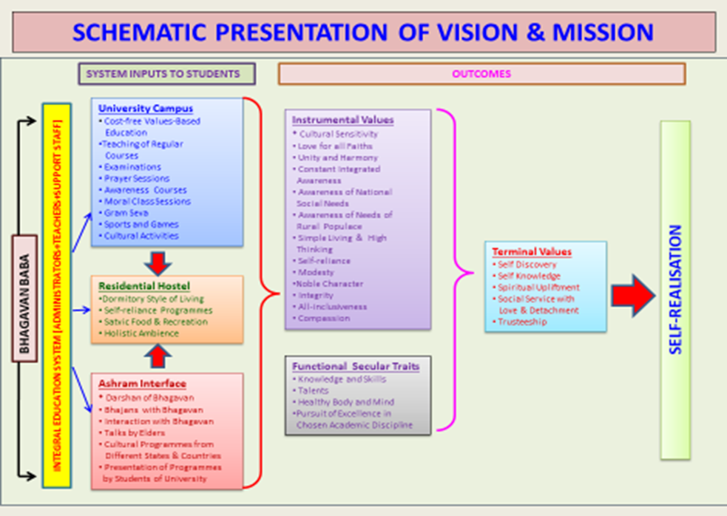

Slide 12
Outcomes of Integral Education
All-round personality development.
Disciplined private/personal life.
Disciplined academic life (Examinations, learning sessions, etc.).
Purposeful/meaningful life during an important stage of life.
Respectful social image.
Good employment opportunities.
Promising career growth.
Holistic ambience (Physical & Non-physical)
Grace of unscheduled ingredient.

Slide 13
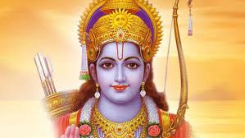
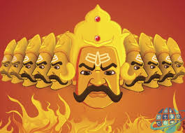
What would you like to Become?

Slide 14
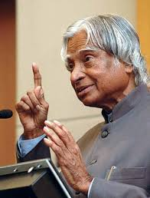
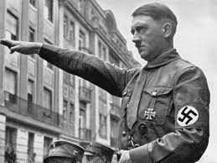
What would you like to Become?

Slide 15
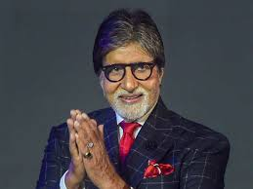
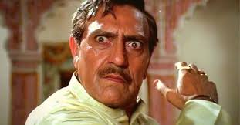
What would you like to Become?

Slide 16

The End & Thank You

